Slide 1
Glossier
Brand Analysis
Group 16

Slide 2
01
Identify the Brand

Slide 3
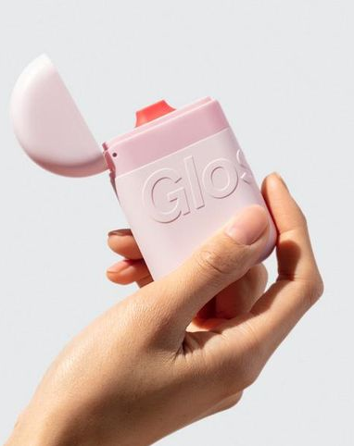
What is Glossier?
Glossier is a beauty brand focusing on natural look makeups, as well as skin and body care products.
Notes:
Glossier is a beauty brand focusing on natural look makeups, as well as skin and body care products. The products turned from social media to magazines such as Forbes, Time, and Vogue. Glossier makes products designed with customers' real beauty routine in mind. It provides skincare, makeup, body care and fragrance, all painstakingly perfected to be worthy of Customer's bathroom shelf.
https://www.forbes.com/sites/pamdanziger/2018/11/07/5-keys-to-beauty-brand-glossiers-success/
Danziger, P. N. (2018, November 7). 5 reasons that Glossier is so successful. Forbes. Retrieved November 27, 2021, from https://www.forbes.com/sites/pamdanziger/2018/11/07/5-keys-to-beauty-brand-glossiers-success/.

Slide 4
History of Glossier
2014-Launched four products
2018-Sold Boy Brow every 32 second
2019-Valuation of $1.2 billion & Merchandise line
2020-Valuation of $1.2 billion & Merchandise line
2021-Successfully built authentic connections with customers
Notes:
After raising an initial $2 million in seed funding, Weiss launched Glossier in 2014 with four products: a moisturiser, a face mist, a skin tint and a lip balm. In 2018, the company claimed to have sold the equivalent of one Boy Brow every 32 seconds. In 2019, Glossier closed a $100 million series D funding resulted in a company valuation of $1.2 billion. The company also started merchandise line
By 2020, it had a total of 36 different products across skincare, makeup and fragrance – a minimalist offering by beauty brand standards.
In 2021, Glossier was successful online because it had built its brand around its personal, authentic connection with its customers.
https://www.wired.co.uk/article/how-to-build-a-brand-glossier
Turk, V. (2020, February 6). How glossier turned itself into a billion-dollar beauty brand. WIRED UK. Retrieved November 27, 2021, from https://www.wired.co.uk/article/how-to-build-a-brand-glossier.

Slide 5
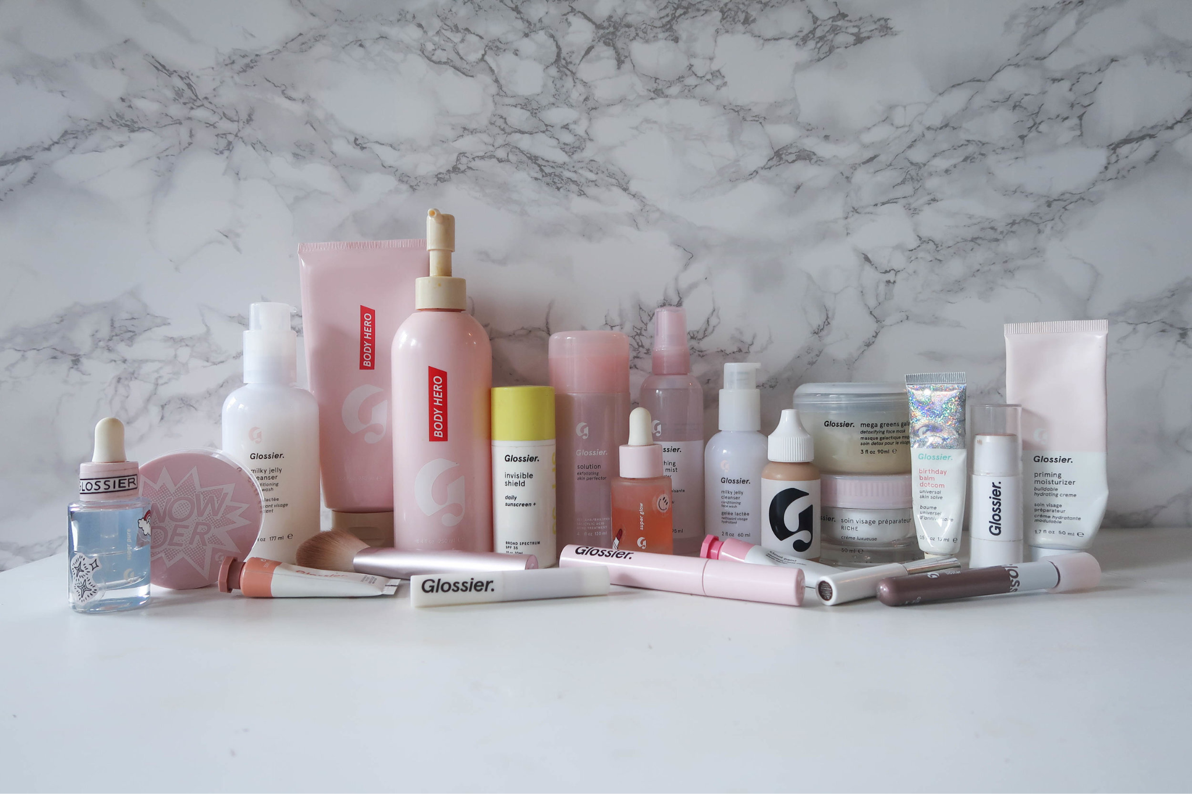
Moisturizer
Face Mist
Face Tint
Lip Balm

Slide 6
02
Brand Positioning Statement

Slide 7
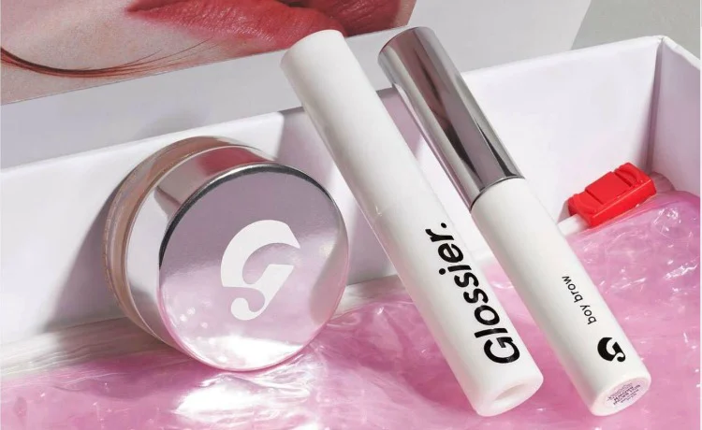
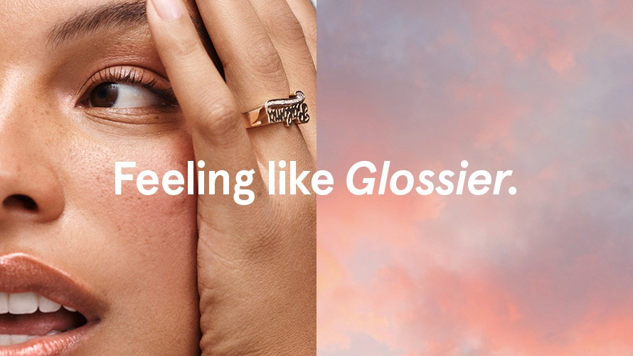
Benefit to the Customer
Glossier is driven by a passionate and unwavering commitment to its consumers' demands and desires. It all begins with the company's direct and personal client interactions.
Notes:
The key thing Glossier represents is the ability of the person to create their own style, to interact with others, to ask questions, and to gain a deeper understanding of the things they desire. Glossier operates solely to meet the needs of individuals who tell us what they desire. Glossier may collect value in the form of real-time feedback and consumer loyalty.
Danziger, P. N. (2018, November 07). 5 Reasons That Glossier Is So Successful. Retrieved from https://www.forbes.com/sites/pamdanziger/2018/11/07/5-keys-to-beauty-brand-glossiers-success/?sh=3e3d6226417d

Slide 8
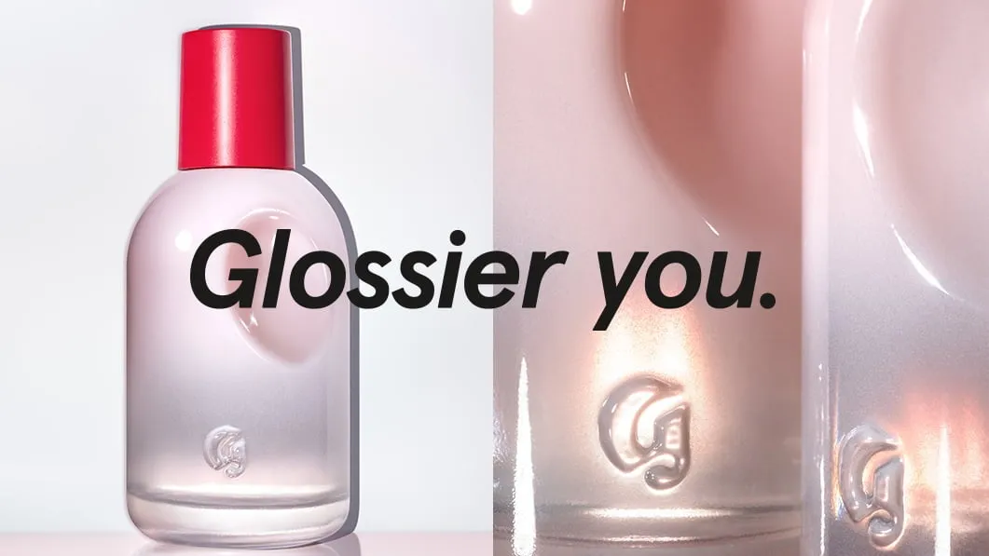
Target Audience
The company accomplishes this through creating products, expanding community, and making choices in ways that are inclusive, customer-centric, curious, brave, and discerning. Glossier believes in the individual's strength and considers beauty as a fantastic means of connecting with others.
Notes:
Glossier primarily caters to female clients between the ages of 16 and 25, who have a restricted budget but value high-quality goods that represent progressive values such as ecology, social justice, and body positivity. Glossier not only caters to female clientele, but they are also making strides in embracing the LGBTQ community. In order to support the LGBTQ community, Glossier presents a pop-up shop in Miami, with $5 contributed to Lambda Legal, a legal defense and LGBT+ rights organization, for every limited-edition Glossier Miami keychain sold. Overall, Glossier reflects and want to represent to be the best version of yourself.
Bold, B. (2019, May 30). Glossier to open Miami pop-up supporting LGBT+ rights. Campaign US. Retrieved November 11, 2021, from https://www.campaignlive.com/article/glossier-open-miami-pop-up-supporting-lgbt+-rights/1580253.

Slide 9

Delivering Promise
Notes:
Glossier's strategy of turning to local Instagram influencers who exemplify the brand's aesthetic is undeniably effective in delivering on their promise. Glossier will target more audience and able to state what the brand actually does, who it serves, and what sets apart through social media platforms. Since Glossier's in-store locations, on the other hand, are limited to certain cities such as London, Seattle, and Los Angeles. Social media has been amazing and a major boost for the color cosmetics side of the beauty industry, it will continue to be a huge opportunity in a new format and able to deliver message.
Danziger, P. N. (2018, November 07). 5 Reasons That Glossier Is So Successful. Retrieved from https://www.forbes.com/sites/pamdanziger/2018/11/07/5-keys-to-beauty-brand-glossiers-success/?sh=3e3d6226417d
Project, T. S. (2017, March 23). The glossier promise. Medium. Retrieved November 9, 2021, from https://medium.com/@tspxyz/the-glossier-promise-5c2c57d4b097.

Slide 10
03
Brand’s Life Cycle
Notes:
Continue to part 3: Brand’s Life Cycle

Slide 11
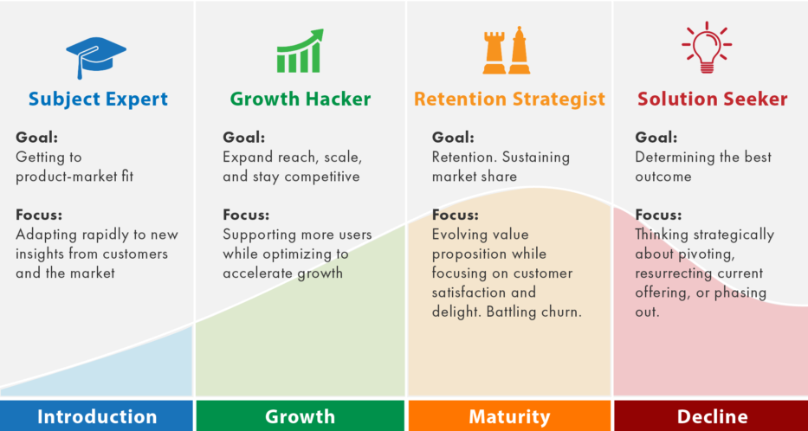
Glossier’s Stage in the Life-cycle：
Growing Rapidly
Notes:
There are four stages in the product life cycle: introduction, growth, maturity, decline.
Situated in Growth stage: since Glossier’s profit increases and peak. Marketing goal is to encourage brand loyalty by increasing the brand’s superior impressions to others. In this stage, marketing strategies include the introduction of product variations to attract market segments and increase market shares. When competitors appear on the scene, marketers must heavily rely on advertising and other forms of promotion. It may faces traditional competitors for consolidating their market shares like L’oreal and Price competitions may develop, and some firms may seek to capture a particular segment of the market by positioning their product to appeal to a certain group. For example, glossier has strived to build a conception of natural beauty make-up to women group.

Slide 12
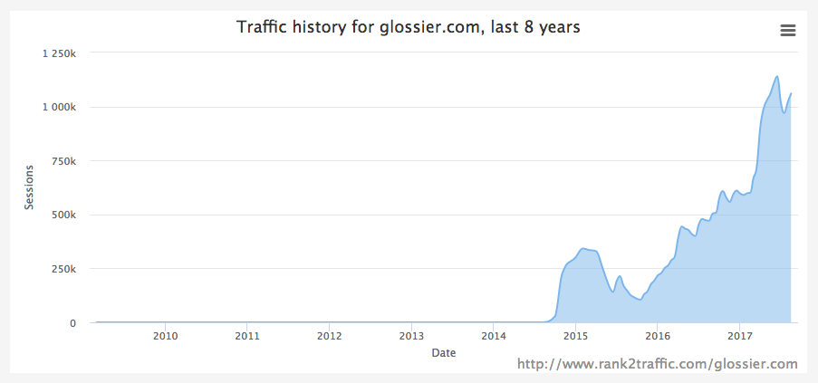
Glossier’s Growth Stage Characteristics
The characteristic of this stage has four aspects
Public awareness increases
Profitability begins to rise
Sales volume increases remarkably
Competition begins to increase with a few new players in establishing market with high investment in advertising and promotion of the product
Notes:
During the growth stage, consumers start become aware of the product itself and decide to buy it. The product concept is proven as it becomes more popular, and therefore sales increase consequently. At the same time, Other companies become aware of the product and its space in the market as it begins to draw more attention and spend more revenue. If competition for the product is especially high, the company may still heavily invest in advertising and promotion of the product to beat out competitors. As a result of the product growing, the market itself tends to expand.
Glossier was launched in 2014. These graphs indicate introduction and growth stages of Glossier.
GlossierMasker. (n.d.). Glossier: Changing the face of the beauty industry by crowdsourcing the magic formula. Technology and Operations Management. Retrieved November 27, 2021, from https://digital.hbs.edu/platform-rctom/submission/glossier-changing-the-face-of-the-beauty-industry-by-crowdsourcing-the-magic-formula/.
Sraders, A. (2021, October 29). What is the product life cycle? stages and examples. TheStreet. Retrieved November 5, 2021, from https://www.thestreet.com/markets/commodities/product-life-cycle-14882534.

Slide 13
04
Brand’s Advertising Strategy
Notes:
Among one of its success factors, its advertising strategies need to be analyzed. Advertising is traditionally defined as a nonpersonal communication from an identified sponsor using the mass media. By using many to many model of marketing communication of strategy, glossier gains enough attentions and take advantage of “word of mouth communication” effect in the following two cases on instagram and youtube

Slide 14
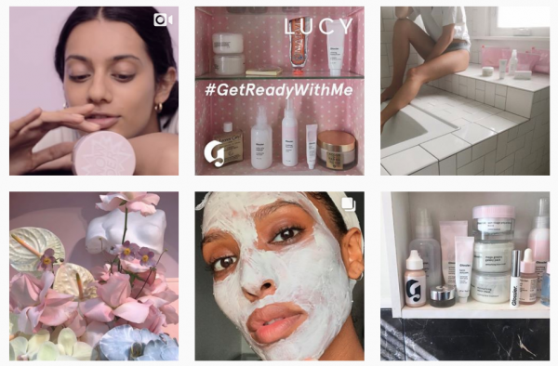
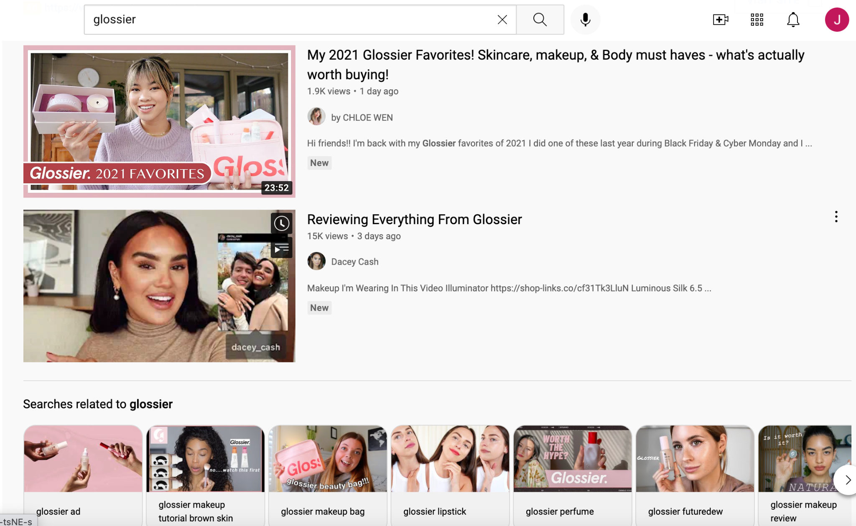
ads case on instagram
ads case on Youtube ads
User-generated content
influencer marketing strategy
Notes:
Keeping focus on their social media presence with Instagram, Glossier’s Instagram has achieved a balance between original content and user-generated content. Having user-generated content is an advantage for Glossier’s social media can allow customer to share their experience on product qualities themselves with the Instagram z generation. They encouraged users to share about their experience given to a specific topic. By taking Advantage of this Story Built-in Features, with over billions daily active users on ins glossier can increase the exposure of the brand awareness.
In the cases of youtube ads, Glossier’s influencer marketing strategy is present on its social channels. In many times, the glossier will use the strategy to match every potential customer based on the searching history and related youtubers of customers. Some of the famous youtubers liked by the audience are talking about Glossier in their review videos, encouraging the audience to get to know more details about this makeup brand
Team, P. byM. S. C. (2020, December 9). Digital Marketing we love: Glossier's Social Media. Marketing Supply Co. Retrieved from https://www.marketingsupply.co/blog/digital-marketing-we-love-glossier/.
Unmetric. (2019, February 13). How glossier built a cult following on social media. Unmetric Social Media Analytics Blog. Retrieved November 25, 2021, from https://blog.unmetric.com/glossier-social-media-strategy.
-, D., says:, I., says:, D., says:, B., says:, K. C., says:, F. P., says:, V. U., &amp; says:, S. L. (2021, July 8). The google ads strategy of glossier (case study). Store Growers. Retrieved November 25, 2021, from https://www.storegrowers.com/glossier-google-ads/.

Slide 15
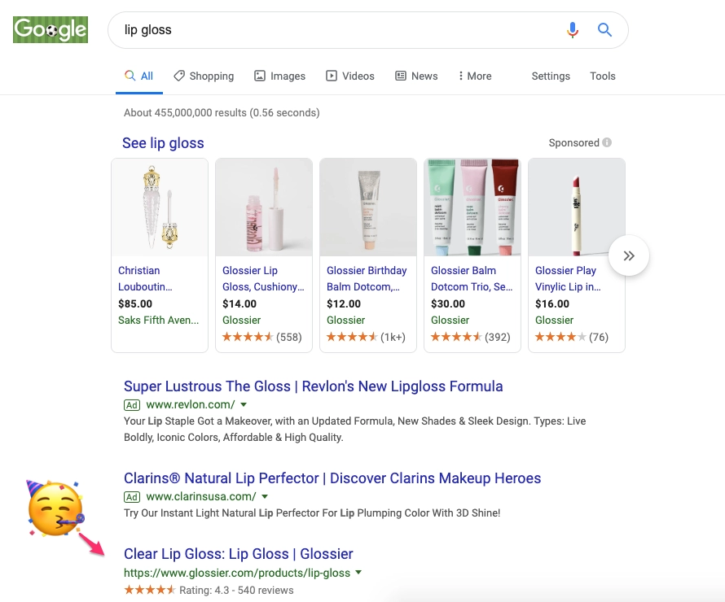
Glossier Google Ads Campaign
 | Money Spent | Clicks | CPC
Search Ads | $40,700 | 64,900 | $0.63
Shopping Ads | $44,285 | 52,100 | $0.85
Notes:
https://www.storegrowers.com/glossier-google-ads/

Slide 16
05
Brand’s Growth Perspective

Slide 17
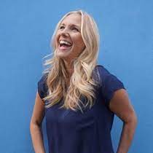


New Executive Team in Glossier
More Flagship Shops
Connect with Customers
Merger and acquisition
Senior Vice President of Retail
Kristy Maynes
Oct 2021
First Chief Commercial Officer
Kyle Leahy
Nov 2021
CFO
Seun Sodipo
Feb 2022
Notes:
In this October, Kristy Maynes serves as senior vice president of retail. She spent past 12 years at Lululemon in multiple leadership roles, and she has lots experience on retail, which means Glossier would expand physically. The new senior vice president of retail will oversee the opening of several flagship shops in the future.
Recently, Kyle Leahy joined Glossier as the first chief commercial officer, she also serves as Cole Haan’s executive vice president and general manager of North America. She is good at general management, e-commerce, and leadership, so she will build customers experiences across channels and driving revenue in Glossier.
What’s more, the new CFO Seun Sodipo who previously led product finance and strategy at Stripe would join Glossier in next February. Sodipo has great experience on mergers and acquisitions, as well as the knowledge of the public markets. Therefore, some experts forecast that Glossier may buy up other brands in the future.
Jansen, C. (2021, November 02). Glossier brings on new CFO, chief commercial officer. Retrieved from https://www.retaildive.com/news/glossier-brings-on-new-cfo-chief-commercial-officer/609310/

Slide 18
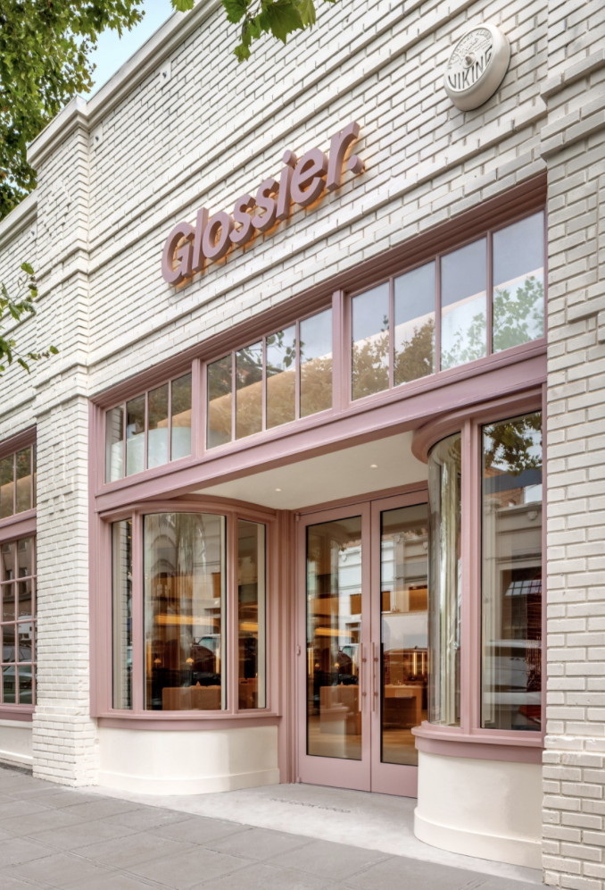
Seattle, WA
Physical Expansion
Due to safety concerns surrounding Covid-19, all physical retail stores were closed.
Glossier opened their Seattle location August 2021, and plan open Los Angeles and London locations by the end of the year.
Notes:
Thanks to Glossier’s wonderful team and loyal consumer base, Glossier was able to survive the pandemic. Although due to safety concerns surrounding Covid-19 in 2020 all of their physical retail stores were closed. Since then Glossier was able to further there expansion opening their Seattle location in August of this year which is known to be their biggest location so far. Along this this Emily Weiss and her team plan to open a store in Los Angeles and London by the end of the year.
Howarth, D. (2021, August 26). Glossier Seattle store features Mossy Mushroom-covered mound. Dezeen. Retrieved November 30, 2021, from https://www.dezeen.com/2021/08/25/glossier-seattle-store-mossy-mushroom-covered-mound/.
Wilson, M. (2021, July 7). Glossier in new funding round, targets online and physical store growth. Chain Store Age. Retrieved November 30, 2021, from https://chainstoreage.com/glossier-new-funding-round-targets-online-and-physical-store-growth.

Slide 19
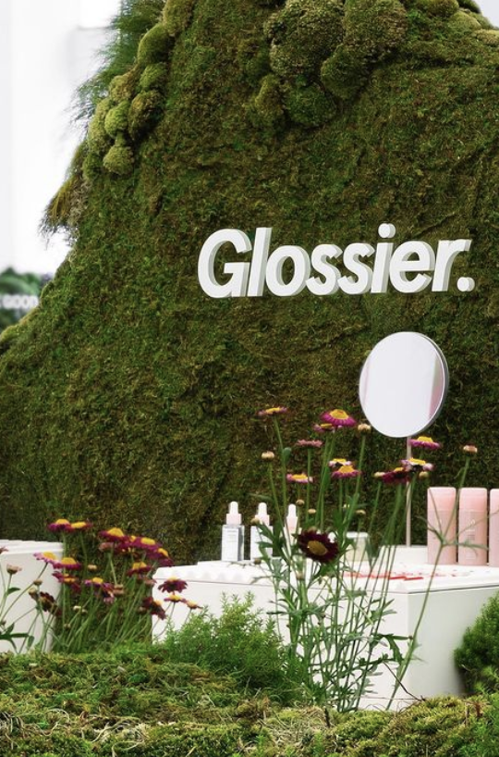
Glossier’s Valuation and Plans
The Company’s valuation is 1.8 billion
Glossier plans to open dozens of new locations across the country and internationally.
Notes:
Glossier raised a grand total of 80 million in Series E funding bringing Glossier’s valuation to 1.8Billion . Big investors such as Lone Pine Capital and Forerunner Ventures are backing the start-up company Glossier as they continue to take the world by storm. Glossier successfully opened two locations so far and plans to open their third in London this winter. Focusing on people first and products second Glossier continues their mission to resonate with their customers making them feel welcomed and giving them a personalized experience.
Kilikita, J. (2021, June 18). Calling all glossier obsessives: A permanent store is coming to London. Glossier Is Opening A Permanent Store In London. Retrieved November 30, 2021, from https://www.refinery29.com/en-gb/glossier-store-london.

Slide 20
Bibliography
Bold, B. (2019, May 30). Glossier to open Miami pop-up supporting LGBT+ rights. Campaign US. Retrieved November 11, 2021, from https://www.campaignlive.com/article/glossier-open-miami-pop-up-supporting-lgbt+-rights/1580253.
Danziger, P. N. (2018, November 7). 5 reasons that Glossier is so successful. Forbes. Retrieved November 27, 2021, from https://www.forbes.com/sites/pamdanziger/2018/11/07/5-keys-to-beauty-brand-glossiers-success/.
GlossierMasker. (n.d.). Glossier: Changing the face of the beauty industry by crowdsourcing the magic formula. Technology and Operations Management. Retrieved November 27, 2021, from https://digital.hbs.edu/platform-rctom/submission/glossier-changing-the-face-of-the-beauty-industry-by-crowdsourcing-the-magic-formula/.
Howarth, D. (2021, August 26). Glossier Seattle store features Mossy Mushroom-covered mound. Dezeen. Retrieved November 30, 2021, from https://www.dezeen.com/2021/08/25/glossier-seattle-store-mossy-mushroom-covered-mound/.
Jansen, C. (2021, November 02). Glossier brings on new CFO, chief commercial officer. Retrieved from https://www.retaildive.com/news/glossier-brings-on-new-cfo-chief-commercial-officer/609310/
Kilikita, J. (2021, June 18). Calling all glossier obsessives: A permanent store is coming to London. Glossier Is Opening A Permanent Store In London. Retrieved November 30, 2021, from https://www.refinery29.com/en-gb/glossier-store-london.
Sraders, A. (2021, October 29). What is the product life cycle? stages and examples. TheStreet. Retrieved November 5, 2021, from https://www.thestreet.com/markets/commodities/product-life-cycle-14882534.

Slide 21
Bibliography
Team, P. byM. S. C. (2020, December 9). Digital Marketing we love: Glossier's Social Media. Marketing Supply Co. Retrieved from https://www.marketingsupply.co/blog/digital-marketing-we-love-glossier/.
Turk, V. (2020, February 6). How glossier turned itself into a billion-dollar beauty brand. WIRED UK. Retrieved November 27, 2021, from https://www.wired.co.uk/article/how-to-build-a-brand-glossier.
Unmetric. (2019, February 13). How glossier built a cult following on social media. Unmetric Social Media Analytics Blog. Retrieved November 25, 2021, from https://blog.unmetric.com/glossier-social-media-strategy.
Wilson, M. (2021, July 7). Glossier in new funding round, targets online and physical store growth. Chain Store Age. Retrieved November 30, 2021, from https://chainstoreage.com/glossier-new-funding-round-targets-online-and-physical-store-growth.
-, D., says:, I., says:, D., says:, B., says:, K. C., says:, F. P., says:, V. U., &amp; says:, S. L. (2021, July 8). The google ads strategy of glossier (case study). Store Growers. Retrieved November 25, 2021, from https://www.storegrowers.com/glossier-google-ads/.

Slide 22
THANK YOU

